Slide 1
MA1506 Mathematics II Group A Monday 800-1000 Wed 1600-1700 UT-AUD1 Lecturer: Chew Tuan Seng Group B Wed 800-1000 Friday 800-900 UT-AUD2 Lecturer: Quek Tong Seng
follow the contents of Lecture Note but our
presentation may be different

Slide 2
Chapter 1
Differential Equations

Slide 3
1.1. Introduction
A differential equation is an equation
containing derivatives or partial derivatives
In this chapter, we deal only with diff. eqs.
containing derivatives, called ordinary diff.
eqs.

Slide 4
1.1. Introduction
1st order ordinary diff. eq.
2nd order ordinary diff. eq.
n^{th} order ordinary diff. eq.

Slide 5
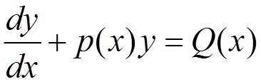
1.1. Introduction
An ODE of the following form is called a linear ODE
Examples:
Above are linear ODEs
Below are NOT linear ODEs

Slide 6
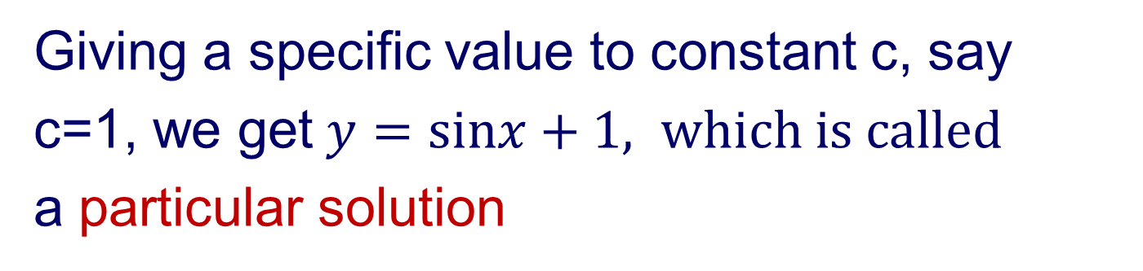
1.1. Introduction
In general, ODE has many solutions, e.g.
, c is an arbitrary constant, is a solution of
Such solutions, containing arbitrary constants
are called general solution
Giving a specific value to constant c, say
c=1, we get$y=sinx+1, which is called$
a particular solution

Slide 7
1.1. Introduction
In this Chapter, we study
1st order ordinary differential equation
and its applications
2nd order ordinary differential equations
Applications of 2nd order will be given in Chapter TWO

Slide 8
1.2 Separable equations
We study 1st order ODE of the following form
We shall learn how to solve separable equations by examples

Slide 9
Example 1
1.2 Separable equations
We write
Then integrate both sides

Slide 10
1.2 Separable equations
Example 1 (cont)
get

Slide 11
Example 2
1.2 Separable equations
Radioactive Decay
A radioactive substance decomposes
at a rate proportional to the amount
present i.e.,
Hence
where k is a constant
Find

Slide 12
Example 2 (cont)
1.2 Separable equations
where

Slide 13
Example 2 (cont)
1.2 Separable equations
What is the value A ?
From
We have

Slide 14
Example 2 (cont)
1.2 Separable equations
Now we shall find the value of k
Assume the half-life of the substance is
So
The half-life is the time
required for half of the substance to decay. So at time , the amount of the substance is ½ x(0)
From
we have

Slide 15
Example 2 (cont)
1.2 Separable equations
Hence we have
Remark: We may use
instead of
We will get the same equation
as in the above

Slide 16
Example 3
1.2 Separable equations
Cooling(Heating) Problem
Temperature of an object at time 0 is
it is placed in a medium of constant temperature
Temperature of the object is
at time (is given)
Find the temperature of the object
at time

Slide 17
Example 3 (cont)
1.2 Separable equations
Physical information:
Rate of change dT/dt of the temperature T
of an object is proportional to the difference
between T and the temp T₀ of the medium
Newton’s Law of Cooling (Heating)

Slide 18
Example 3 (cont)
1.2 Separable equations
We assume
cooling so
What is the value of A?

Slide 19
Example 3 (cont)
1.2 Separable equations
Now we shall find k
By given, we know the value of
So

Slide 20
Example 3 (cont)
1.2 Separable equations
Hence we have
where k is given above
Similarly, for heating,
,we get the same formula

Slide 21

Example 4
1.2 Separable equations
Retarded fall—air resistance
Newton’s 2nd Law
m=weight of the man + equipment
air resistance = bv²
where b is a constant
g=acceleration due to gravity
=9.8m/s²
0
Starting pt
We shall discuss the case when
air resistance = bv in Example 9

Slide 22
Example 4 (cont)
1.2 Separable equations
where

Slide 23
Example 4 (cont)
1.2 Separable equations

Slide 24
Example 4 (cont)
1.2 Separable equations
where
How to find c?

Slide 25
Example 4 (cont)
1.2 Separable equations
Now suppose
K=4.87, c=0.345,p=4.02
Then

Slide 26
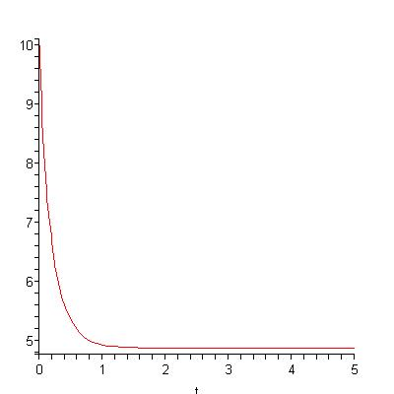

Example 4 (cont)
1.2 Separable equations
V(t)
Skydiver falling at terminal velocity
t

Slide 27
We can draw graph using
graphmatica
at
http://www.graphmatica.com

Slide 28
Example 5
1.2 Separable equations
Mixture problem
air or
pure water
air with CO or
water with salt
CO or salt
Some substance (e.g. CO, salt)
flows into a tank (room), is mixed
uniformly with the contents (e.g. air ,
pure water) of the tanks,
and flows out with the mixture (air with CO,
water with salt).

Slide 29
Example 5 (cont)
1.2 Separable equations
We want to find the amount x(t) of
the substance in the tank at time t
the rate at which the substance
flows into the tank (in flow)
the rate at which the substance
flows out the tank (out flow)
Now we shall give an example.

Slide 30
Example 5 (cont)
1.2 Separable equations
Mixture problem
A 2000m³ room contains air with 0.002% CO at time t=0
The ventilation system blowing in air which contains 3% CO
The system blowing in and out air at a rate of 0.2m³/min

Slide 31
Example 5 (cont)
1.2 Separable equations
Let x(t) = vol of CO in the room at time t
0.2 m³ /min
3% CO
X(t)
0.2 m³ /min
Room 2000 m³
Inflow of CO - outflow of CO
CO per m³ in the tank

Slide 32
Example 5 (cont)
1.2 Separable equations

Slide 33
Example 5 (cont)
1.2 Separable equations
Now we shall find k
A 2000m³ room contains air with 0.002% CO at time t=0. Hence
X(0)=2000x0.002%=2000x0.002/100=0.04

Slide 34
Example 5 (cont)
1.2 Separable equations

Slide 35
Example 5 (cont)
1.2 Separable equations
When the air in the room
containing 0.015% CO?
0.015% CO means x(t₁) = 0.00015 X 2000 = 0.3

Slide 36
What happens when ODE is not separable? For examples,
1.2 Separable equations
2 tricks:
reduction to separable
linear change of variables

Slide 37
Reduction to separable form
1.2 Separable equations
Suppose
Set
Now we shall give one example

Slide 38
Example 6 : Reduction to separable form
1.2 Separable equations
Let
We have
See previous slide
where

Slide 39
Example 6 (cont)
1.2 Separable equations

Slide 40
Example 6 (cont)
1.2 Separable equations

Slide 41
Linear Change of Variable
1.2 Separable equations
Consider ODE of the form
We shall give one example to illustrate
the method

Slide 42
Example 7
1.2 Separable equations
Let u=x-2y
We may let u=-x+2y
The above can be done since two st lines
-x+2y-3=0 and 2x-4y+5=0 are parallel

Slide 43
Example 7 (cont)
1.2 Separable equations
Let u=x-2y
Then
subst into
the above eq

Slide 44
Example 7 (cont)
1.2 Separable equations

Slide 45
1.3 Linear 1st Order ODEs
Std form
called Integrating factor
The given ODE multiplied by integrating factor, get

Slide 46
1.3 Linear 1st Order ODE
cont.
We can check that the left hand side of the above

Slide 47
1.3 Linear 1st Order ODE
cont.
Hence
S0
Hence

Slide 48
1.3 Linear 1st Order ODE
cont.
Why

Slide 49
1.3 Linear 1st Order ODE
cont.
Why
Use the following example to illustrate

Slide 50
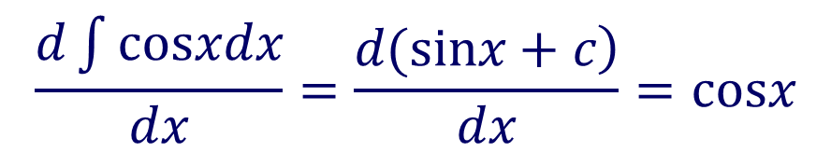
1.3 Linear 1st Order ODE
cont.
$$\frac{d\int{cosxdx}}{dx}=\frac{\left.d(sinx+c\right)}{dx}=cosx$$

Slide 51
Example 8 (i)
1.3 Linear 1st Order ODE
Use formula
First compute integrating factor

Slide 52
1.3 Linear 1st Order ODE
cont.
Hence, from
we have
Lecture Note Example 8 (ii) Exercise

Slide 53

Example 9
1.3 Linear 1st Order ODE
Retarded fall—air resistance
An object of mass m dropped from rest
0 starting pt
A resistance to the object is proportional to the magnitude of the velocity of the object.
Newton 2nd Law
Find the position x(t) and velocity v(t) at time t.
(Similar problem has been discussed in Example 4)

Slide 54
1.3 Linear 1st Order ODE
cont.
Integrating factor
By formula
How to find c?
Use v(0)=0, from above, get

Slide 55
1.3 Linear 1st Order ODE
cont.

Slide 56
1.3 Linear 1st Order ODE
cont.
How to find d? use x(0)=0, from above, get

Slide 57
Example 10
Mixture Problem
1.3 Linear 1st Order ODE
Let Q(t) be the amount of salt in the tank
Q(0)=20
amt of water = constant=100 gal
3 gal/sec salt=0.25lb/gal
=inflow - outflow
100 gal water
3 gal/sec
salt/gal
amt of water
= constant
=100 gal

Slide 58
cont.
1.3 Linear 1st Order ODE
Use formula
get
Similar problem has been discussed in Example 5

Slide 59
Example 11
A decay chain
1.3 Linear 1st Order ODE
In Example 2, we have discussed radioactive
decay. However, some radioactive elements
are transformed into unstable elements.
The product (e.g., Thorium 230) of a radioactive
(e.g., Uranium 234) decay is
itself a radioactive element

Slide 60
cont.
1.3 Linear 1st Order ODE
Let U(t) be the amount of Uranium at time t.
Let T(t) be the amount of Thorium at time t.
We assume that each decay of one Uranium
atom produces one Thorium atom.
Hence Thorium atoms are being born at exactly the same rate at which
Uranium atoms die.
Birth rate of Thorium=(-1)Death rate of Uranium
So we have

Slide 61
cont.
1.3 Linear 1st Order ODE
Thorium atoms are being born at exactly the same rate at which
Uranium atoms die
Uranium
Thorium
We assume

Slide 62
cont.
1.3 Linear 1st Order ODE
We shall solve the above system of ODEs
From the 1st equation, we have
See Example 2
Hence 2nd equation
becomes

Slide 63
cont.
1.3 Linear 1st Order ODE
It is 1st order linear ODE. Hence by formula,
see Section 1.3, slide 47, we get

Slide 64
cont.
1.3 Linear 1st Order ODE
Now we shall find the constant C. By given
We get

Slide 65
cont.
1.3 Linear 1st Order ODE
Unfortunately, we don’t know
However
So

Slide 66
cont.
1.3 Linear 1st Order ODE
Hence we can find the time t
if we know the ratio
It is known that
Hence
as

Slide 67
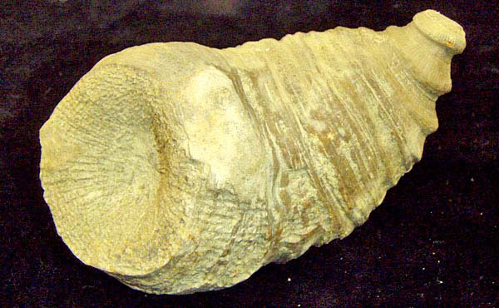
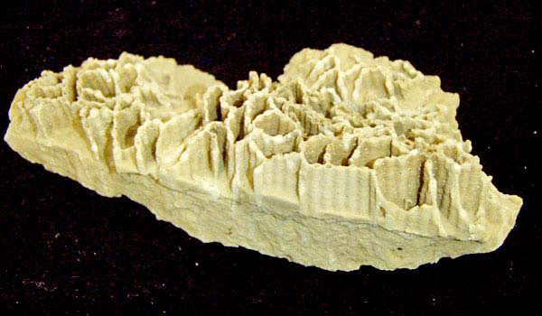
1.3 Linear 1st Order ODE
ancient corals
How old the above ancient corals?
If we know
then we know the answer

Slide 68
Bernoulli Equations p23
1.3 Linear 1st Order ODE
If n=0 or n=1, then it is 1st order linear ODE,
which has been just discussed
y^{-n}
Given eq multiplied by (1-n) get

Slide 69
cont.
1.3 Linear 1st Order ODE
Let
Then
So, from
we get
Hence Bernoulli equation becomes
1st order linear ODE

Slide 70
Example (ii) Bernoulli Equation p24
1.3 Linear 1st Order ODE
Set
By formula
get
Solve this 1st order linear ODE, get
Example (i) see Lecture note

Slide 71
cont.
1.3 Linear 1st Order ODE
Integration by parts

Slide 72
Review: First Order ODE
1st Order ODE
Separable
Linear
Bernoulli

Slide 73
cont.
1st Order ODE
has many solutions.
However if an initial condition y(x₀)=y_{0,} (very often x₀=0) is given,
then there is one and only one solution,
i.e., the solution is unique.

Slide 74
1st Order ODE
Review: Applications of 1st order ODE
Radioactive Decay
Cooling (Heating)
Retarded fall-air resistance
Mixture problem
Radioactive Decay chain

Slide 75
1.4 Second order linear ODE
The general form of 2nd order linear ODE is
When F(x) is zero function, we have
This equation is called homogeneous.

Slide 76
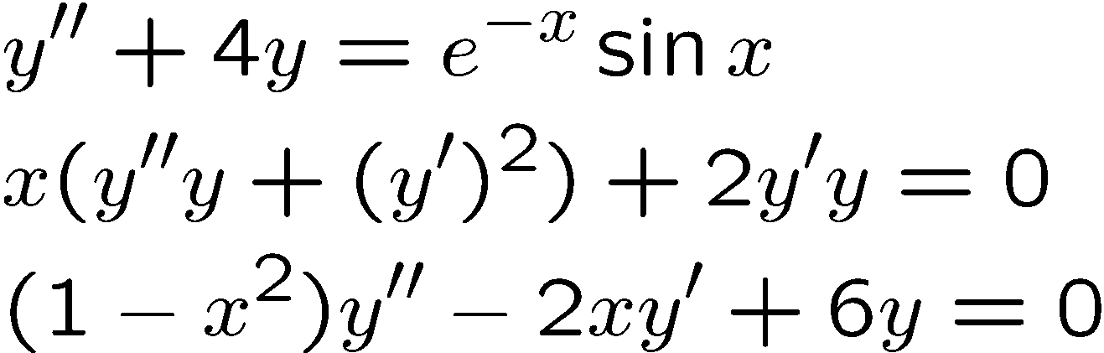
1.4 Second-order linear ODE
When F(x) is not zero function,
is called nonhomogenous.
Examples
linear, nonhom
nonlinear
linear, hom

Slide 77
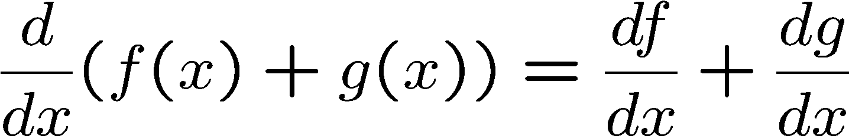
Superposition principle (only for homogeneous case) p27
1.4 Second-order linear ODE
If y₁ and y₂ are solutions then
c y₁ + d y₂ is also a solution
To prove the above result, first recall

Slide 78
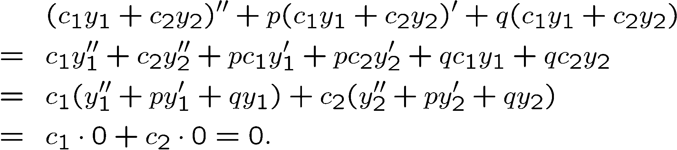
Proof: Superposition principle
1.4 Second-order linear ODE
If y₁ and y₂ are solutions then so is c y₁ + d y₂

Slide 79
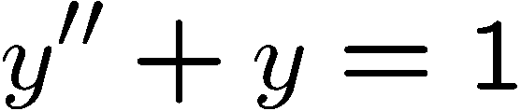
Caution
1.4 Second-order linear ODE
Superposition principle does not hold for nonhomogeneous ODE
are solutions but
is Not a solution

Slide 80
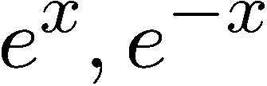

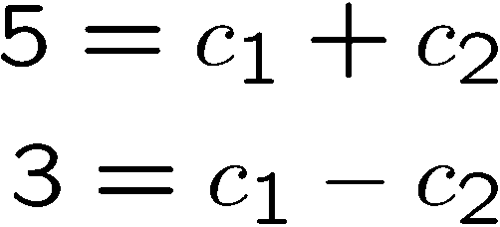

Example 12
1.4 Second-order linear ODE
Solve
initial value condition
First we can check that
are solutions.
By superposition principle,
is a solution
So
By initial value condition , we get

Slide 81
Linearly independent p29
1.4 Second-order linear ODE
Two solutions u(x) and v(x) are said to be linearly dependent
if we can find a constant c such that
u(x)=cv(x), for all x, otherwise they are
linearly independent
For examples, sinx and cosx are linearly indep; sinx and 2sinx are linearly dep.

Slide 82
Theorem: For Hom. 2nd order linear ODE
1.4 Second-order linear ODE
If y₁ and y₂ are linearly independent solutions then general solution is y = c₁ y₁ + c₂ y₂
Particular solution: Fix some values of c₁ and c₂

Slide 83
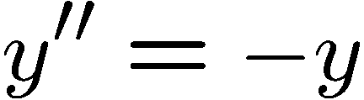


Example
1.4 Second-order linear ODE
two linearly indep solutions
General solution
Particular solution

Slide 84
Homogeneous ODE with constant coefficient p31
1.4 Second-order linear ODE
My presentation is slightly
diff from the L N
It is clear that
zero
function is a solution
which is called a trivial solution or zero solution

Slide 85
1.4 Second-order linear ODE
(cont)
Now we shall look for nontrivial (nonzero) solution
Recall that the general solution of first linear
homogeneous ODE
is

Slide 86
1.4 Second-order linear ODE
(cont)
Consider a special case: when p(x) is constant , say D. Then the general solution is
From this solution , we may guess that
a nontrivial solution
of
is of the form

Slide 87
1.4 Second-order linear ODE
(cont)
Then
Subst. these into the given ODE, get
Thus
Hence
which is called characteristic equation
or auxiliary equation
.

Slide 88
1.4 Second-order linear ODE
(cont)
When solving
there are three cases: (See p32)
Two distinct real roots
Only one real root
Two distinct complex roots

Slide 89
1.4 Second-order linear ODE
(a) Two distinct real roots
Suppose that two distinct real roots
are and
Then we have two distinct (linearly
independent) solutions
General soln is

Slide 90
1.4 Second-order linear ODE
(cont)
In fact , we can prove that every solution
is of the form
Here and are any constants.

Slide 91


Example 13
1.4 Second-order linear ODE
Solve
$$y"+y′−2y=0$$
with
$$y(0)=4,y"(0)=−5$$
Solution: Let
Subst this y into the given ODE , get
We have two distinct real roots,

Slide 92
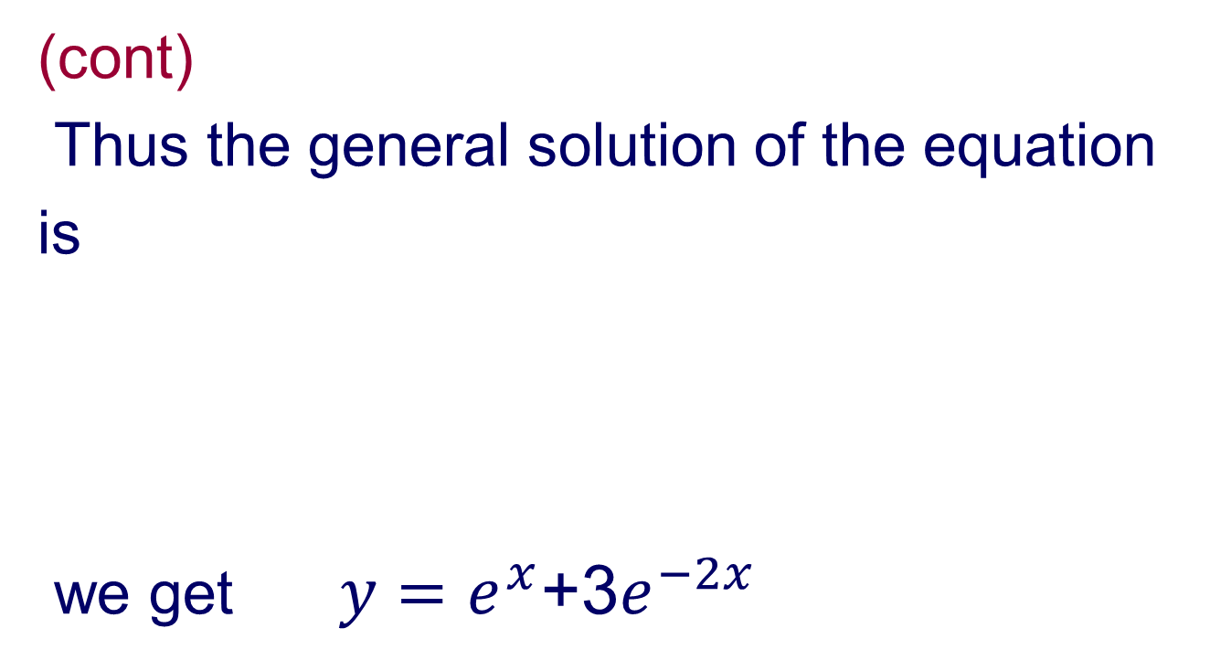

1.4 Second-order linear ODE
(cont)
Thus the general solution of the equation
is
we get$y=e^{x}$+3$e^{−2x}$
By initial condition,
$$y(0)=4,y′(0)=−5$$

Slide 93
1.4 Second-order linear ODE
(b)Only one real root
Suppose that the only one real root is
Then we have a solution
For 2nd order ODE, we can prove
that we should have two distinct (linearly indep.) solutions.
What is the 2nd solution?

Slide 94
1.4 Second-order linear ODE
(cont)
The 2nd solution is
We can verify that (see p34)
is also a solution (superposition principle)
In fact , we can prove that every solution is of the form

Slide 95
1.4 Second-order linear ODE
Example14 (ii): Solve
The auxiliary equation is
We have only one solution
Hence the general solution is
(Example 14 (i) Exercise )

Slide 96
1.4 Second-order linear ODE
(c) Two distinct complex roots
Suppose that we have two distinct
complex roots, namely and
Then we have two distinct (linearly indep)
complex-valued solutions
and
Suppose that
Then

Slide 97
1.4 Second-order linear ODE
(cont)
Note that these two solutions are
complex-valued . However we want
real-valued solutions.
How to get real-valued solutions ?
We shall look at the real part and imaginary
part of the complex-valued solution

Slide 98
1.4 Second-order linear ODE
(cont)

Slide 99
1.4 Second-order linear ODE
(cont)
We can verify that
the real part
and the imaginary part
are two (real-valued) solutions

Slide 100
1.4 Second-order linear ODE
(cont)
we can prove that every solution is of the form

Slide 101
1.4 Second-order linear ODE
(cont)
Do we need to consider
ANS: NO, since it induces the same
general solution.

Slide 102
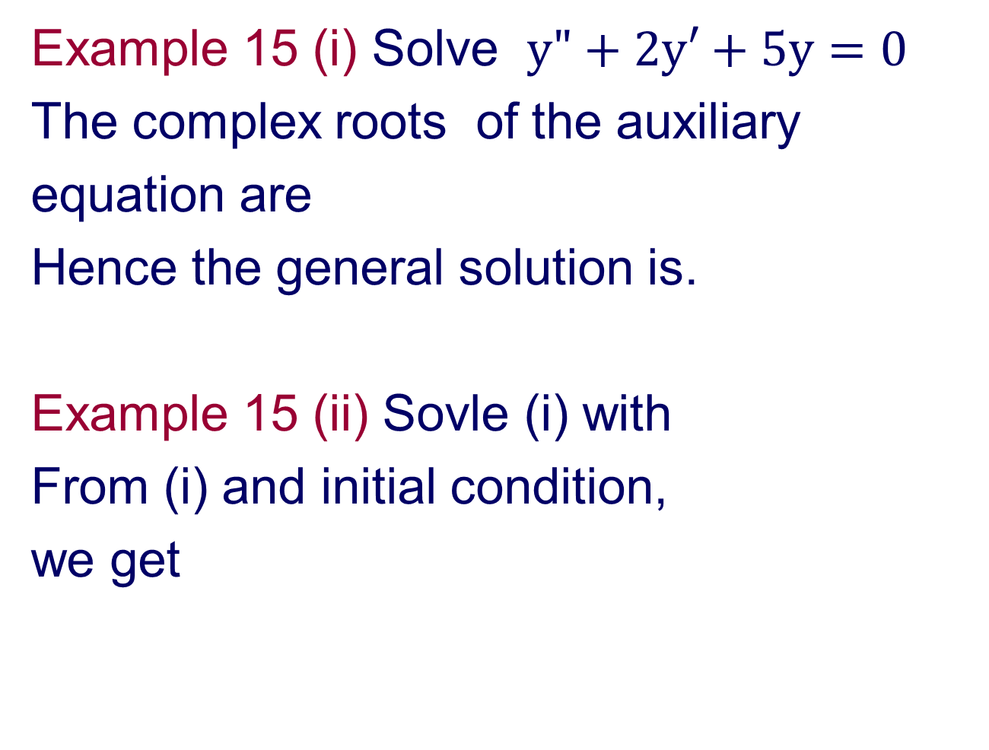
1.4 Second-order linear ODE
Example 15 (i) Solve $y"+2y′+5y=0$
The complex roots of the auxiliary
equation are
Hence the general solution is.
Example 15 (ii) Sovle (i) with
From (i) and initial condition,
we get

Slide 103
2nd-order nonhomogeneous linear ODE
1.4 Second-order linear ODE
From now onwards till the end of this chapter,
pp 38-54, my presentation is different from the L. N. .
However, the content remains unchanged.
We deal only ODEs with constant coefficients

Slide 104
2nd-order nonhomogeneous linear ODE with constant coefficients
1.4 Second-order linear ODE
The general form is
Solving this equation can be reduced to
three steps
1.Find the general solution to the homogeneous equation
, say the solution is

Slide 105
1.4 Second-order linear ODE
2. Find a particular solution to the nonhomogeneous equation
3. Add the solutions from step 1
and step 2 , get +
,which is the general solution to
(see Appendix 1)

Slide 106
1.4 Second-order linear ODE
We have learnt step 1. There are two
methods for step 2.
Method 1.
The method of undetermined coefficients.
Method 2.
The method of variation of parameters.
Now we shall use examples to
illustrate method 1

Slide 107
Method 1.
The method of undetermined coefficients
Example 1
Guess a solution?
If the function R(x) on the right hand side
is constant, then we can guess that
This is always true except some special but important cases, see Examples 3-6

Slide 108
1.4 Second-order linear ODE
Example 2
Solve
Can we guess a solution?
No, no
The correct form is

Slide 109
1.4 Second-order linear ODE
(cont)
Now shall find A, B, C
First
Subst above into
get
So
2C-B-2A=0
-2C-2B=0
-2C=4
Hence

Slide 110
1.4 Second-order linear ODE
(cont)
Hence
is a particular solution of
On the other hand
is the general solution of

Slide 111
1.4 Second-order linear ODE
(cont)
Therefore
is the general solution of the
nonhomogeneous ODE
Here and can be any constant

Slide 112
1.4 Second-order linear ODE
(cont)
Now we shall consider two special
but important cases
The general solution of
is
Hence constant functions are solutions of
This result will be used in Examples 3-4

Slide 113
1.4 Second-order linear ODE
(cont)
Now consider 2nd case
The general solution of
is
Hence constant functions and
functions are solutions of
This result will be used in Examples 5-6
Example 3
A particular solution of
is of the form
Why we have extra term x

Slide 114
1.4 Second-order linear ODE
(cont)
The guiding principle is:
Need to ensure that no term in a
particular soln is a soln of the corresponding
homogeneous ODE
If we let
then we can’t find such A, since constant A
is a soln of
The correct form is
Subst this into
get
So

Slide 115
1.4 Second-order linear ODE
Example 4
A correct form of
Suppose we let
Then we can’t find such A and B, since in
this particular solution , there is one term,
namely, A, is a solution of
Subst.
into
get
So

Slide 116
1.4 Second-order linear ODE
Example 5
The correct form of
We can’t let
Since they are solutions of the corresponding
homogeneous ODE
Subst.
into
get A=5
so
In fact, we can get this result by integrating
the ODE
twice

Slide 117
1.4 Second-order linear ODE
Example 6
The correct form of
We can’t let
See Example 5
Since A, xA are solutions of the corresponding
homogeneous ODE
Subst.
into
get A=B=C=0, D=1/20
So
In fact, we can get this result by integrating
the ODE
twice

Slide 118
Important Remark:
From the above examples, we know that
a particular solution of
not only depend on R(x) but also depend on
the general solution of
So when we want to find a particular solution,
first we need to find the general solution of

Slide 119
1.4 Second-order linear ODE
Example 7
(A)The general solution of
is
(1)A particular solution of
is of the form
(2)A particular solution of
is of the form

Slide 120
(cont)
1.4 Second-order linear ODE
(B)The general solution of
is
So a particular soln of
is of the form

Slide 121
1.4 Second-order linear ODE
(cont)
Why we have extra term
in
Since
are solutions of

Slide 122
1.4 Second-order linear ODE
Example 8
Solve
First the general solution
of
is
We guess a particular solution is of the form

Slide 123
1.4 Second-order linear ODE
cont.
A particular solution
As in Example 2, we can find the values of A and B

Slide 124
1.4 Second-order linear ODE
cont.
Hence a particular solution is
So the general solution of
is

Slide 125
1.4 Second-order linear ODE
Example 9
Find a particular soln of
First, the general soln of
is

Slide 126
1.4 Second-order linear ODE
(cont)
A particular soln is of
the form
with the extra term
since Asinx and Bcosx are solutions of

Slide 127
1.4 Second-order linear ODE
(cont)
We can check that
Hence a particular soln is
The general soln of
is

Slide 128
Review
2nd order nonhomogeneous linear ODE
The general solution is
+
The general soln
for homogeneous ODE
A particular soln for
nonhomogeneous ODE
How to find

Slide 129
How to find
The method of undetermined coefficients.
Notation used in the following slides

Slide 130
Four basic and important cases
S=0,1,2
(1)
(2)
(3)
(4)

Slide 131
What is s?
s is the smallest nonnegative integer
such that no term in
is a solution of the corresponding homogeneous ODE (or corresponding homo. Complex-valued ODE)
What is the meaning of term used above?
In the above, there are four terms

Slide 132
1.4 Second-order linear ODE
Four more Examples 10-13,
computations are very involved
Example 10
Consider
We can guess that a particular soln is
By the method used in previous
examples, we can find A, B, C, D.
However the computation is very
involved. We will use the following
method to simplify the computation

Slide 133
1.4 Second-order linear ODE
(cont)
Let
Then a particular soln is
We have
Subst the above into the given ODE, get,

Slide 134
1.4 Second-order linear ODE
(cont)
Now subst
into
We can find A,B, C, D, we get
Thus a particular soln is

Slide 135
Remark: When we subst.
into the given nonhom. ODE, we do not compute the derivative of the right-hand side of
until the last step
Example 11 See Appendix 4

Slide 136
Example 12
1.4 Second-order linear ODE
A particular soln is of the form
Why we have extra term x in the above?
Since Bsin2x and Dcos2x are solns of

Slide 137
1.4 Second-order linear ODE
(cont)
Again, it is not easy to find A,B,C, D.
We shall use the method in Example
10 to find a particular soln.
Furthermore, we need to use
the corresponding complex -valued ODE
to help us

Slide 138
To find a particular soln of
(cont)
1.4 Second-order linear ODE
first notice that
So now we consider the corresponding complex-valued ODE
where z is a complex–valued function ,
say z (x)=w(x)+iy(x)

Slide 139
(cont)
1.4 Second-order linear ODE
Remark (*) :
The imaginary part of
is
So if z(x) is a complex soln of
Then the imaginary part Im(z) of z is a
soln of

Slide 140
1.4 Second-order linear ODE
(cont)
As in Example 10, we assume a particular soln is
where
A, B are complex numbers
Why we have extra term x in u

Slide 141
1.4 Second-order linear ODE
(cont)
Since
is a solution of the corresponding hom. ODE
Now from
We compute
Subst. them into
we get

Slide 142
1.4 Second-order linear ODE
(cont)
Subst into the
equation , we get
So

Slide 143
From the remark (*), we have
(cont)
1.4 Second-order linear ODE
Now look at what we have done
Example 13 See Appendix 5

Slide 144
1.4 Second-order linear ODE
We remark that so far we only consider
nonhomogeneous ODE with one term
on the right hand side, e.g.,
How to solve the case when right hand side
has more than one term, see next example

Slide 145
Example 14
1.4 Second-order linear ODE
We known that a particular soln of
is
A particular soln of
is
Then a particular soln of
is

Slide 146
Remark: Method of undetermined coeff only works for the following
1.4 Second-order linear ODE
constant
Polynomials
Exponentials
Sine/Cosine
Sum or product of the above functions

Slide 147
Method 2: Method of Variation of Parameters
1.4 Second-order linear ODE
Suppose that the general solution of
homogeneous ODE
is
Then a particular solution of the
corresponding nonhomogeneous ODE
is

Slide 148
(cont)
1.4 Second-order linear ODE
How to find u(x) and v(x)?
We can find u and v by using the following
two equations
Solving these two equations, get

Slide 149
(cont)
1.4 Second-order linear ODE

Slide 150
1.4 Second-order linear ODE
Example1
Solve
First note that
is the general soln of
Hence a particular soln of
is

Slide 151
1.4 Second-order linear ODE
(cont)
Need to use
From
get
So

Slide 152
1.4 Second-order linear ODE
(cont)
get

Slide 153
1.4 Second-order linear ODE
(cont)
A general soln of
is

Slide 154
Example 2
1.4 Second-order linear ODE
The general soln of
is
Hence a particular soln of
is

Slide 155
(cont)
1.4 Second-order linear ODE

Slide 156
(cont)
1.4 Second-order linear ODE
See Appendix 2
See Appendix 3
END

Slide 157
Appendix 1 Optional General soln of nonhomogeneous ODE
General Solution
where
We can check that

Slide 158
Appendix 2

Slide 159
Appendix 2 (cont)

Slide 160
Appendix 3
Hence

Slide 161
Appendix 4 Example 11
Consider
First note that
has only one root
the general soln of
is

Slide 162
(cont)
So a particular soln of
is of the form
Note that we have extra term above
By method used in Example 10 , we can
get A=1,B=C=D=0

Slide 163
(cont)
Why we have extra term
Suppose we use
Then
and
are solns of
Suppose we use
Then
is a soln of

Slide 164
(cont)
Here we use
to ensure that no term in the above is a soln of
We remark that in Example 10, we use
since no term in the above is a soln of

Slide 165
(cont)
The meaning of “term”
There are four terms
in the above particular solution
We have to ensure that no term in
a particular solution of nonhom. ODE is
a solution of the corresponding hom. ODE

Slide 166
Appendix 5 Example 13
As in Example 12, we consider
A particular soln is of the form
where
Why we have extra term x in u(x)?
As in example 12, we can find A and B.
The real part of z(x) is a particular soln of y-equation .

Slide 167

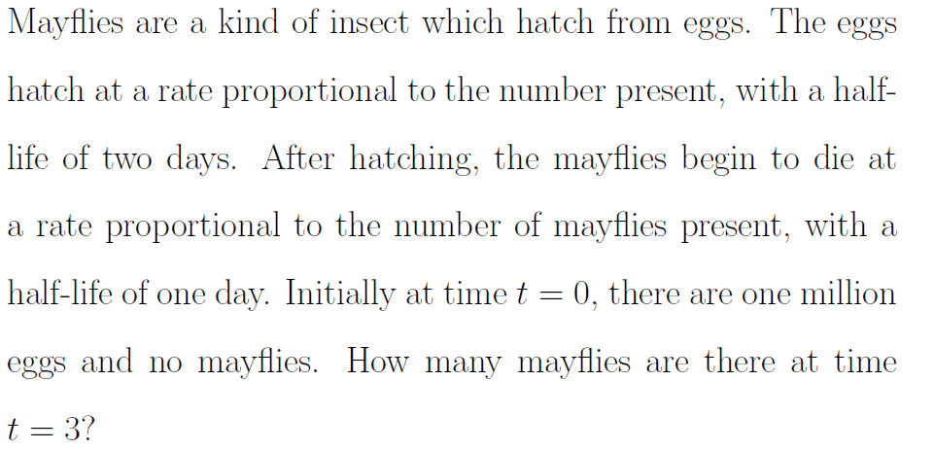
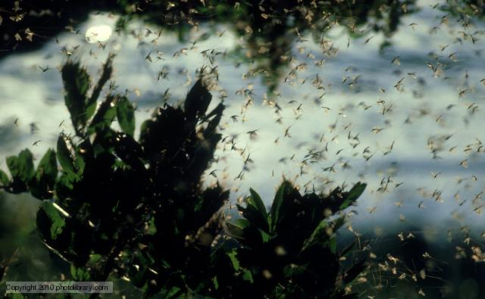
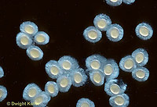
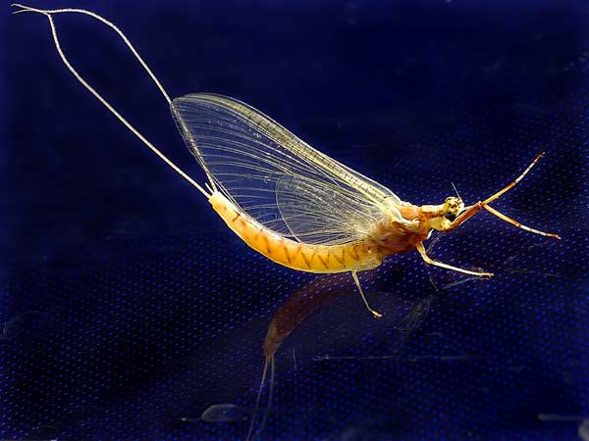
Appendix 6 Example
one of the most short-lived animals
in the world
Radioactive Decay Chain

Slide 168
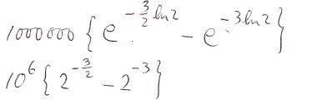
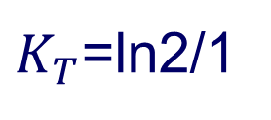
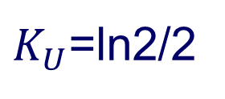
U(t)=# of eggs
T(t)=# of mayflies
$K_{U}$=ln2/2
ANS:
$K_{T}$=ln2/1

